Slide 1
Civil engineering branches & scopes
Title -: Elements of civil engineering
Name -: Nilesh m Nandpal
Dept -: civil
roll no -: 101

Slide 2
Branches of civil Engineering
Civil engineering is a wide field and includes many types of structures such as residential buildings, public buildings , industrial buildings , roads , bridges , tunnels , railways , dams , canal structures , airports , harbours and ports , water treatment plant , waste water treatment plant water supply network and drainage network

Slide 4
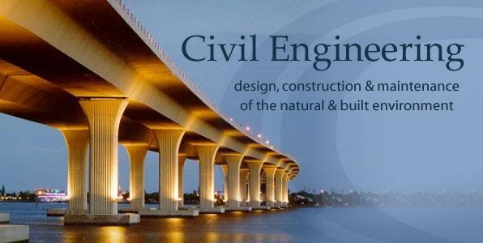
. According to the types of structure and activities carried out, main branches of civil engineering are classified as follows
(1) surveying & levelling
(2) buildings, planning & construction
(3) advanced construction
(4) structural engineering
(5) geotechnical engineering
(6) water resources engineering
(7) transportation engineering
(8) environmental engineering
(9) town planning

Slide 5
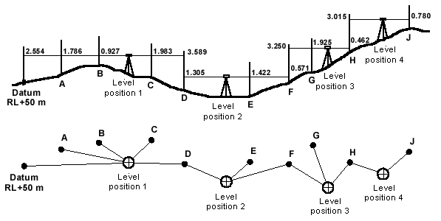
(1) surveying & levelling
Surveying includes measurements of distances and angle in horizontal and vertical planes , while levelling is the measurement of heights in vertical plane.
(2) buildings, planning & construction
Building are planned according to the fundamental principles of planning and bye – laws of local municipal bodies.

Slide 6
(3) Advance construction
construction of dams, bridges , tunnels, ports etc . requires server advanced techniques of construction.
(4) structural engineering
This branches of civil engineering deals with the structural analysis & design of structures.

Slide 7
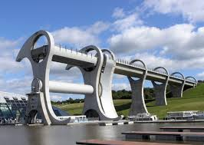
(5) geotechnical engineering
geotechnical engineering is that field of civil engineering which deals with soil investigation & design of proper foundations of structures
(6)water resources engineering
Water resources engineering means measurements , utilization,& development of water resources for agriculture , municipal & power generation purpose

Slide 8
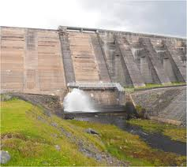
(7) transportation engineering
transportation engineering means movement of passengers & goods by means of vehicles on land, ships on water & aircraft in air
(8) environmental engineering :
environmental engineering deals with pollution control & public healty engineering.
Major environmental problems which mankind is facing now are pollution of environment , global warming, acid rain depletion of ozone layer & depletion in natural resources

Slide 9
(9) town planning
town planning means planned and controlled growth of town by diving land of the town in to the different land use zones & regulating building construction to provide better environment for the people of the town.
Planning of a very large area covering several towns & villages is known as regional planning.

Slide 10
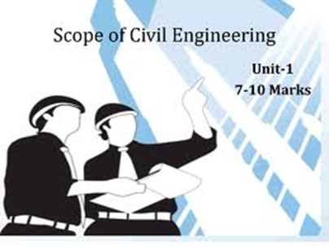
scope of civil engineering
The scope of civil engineering is two fold:
{1} according to the fild of work area of services & type of the structure
{2} function of civil engineering
(1) scope of civil engineering according to the field of work, area of services & type of the structure ::

Slide 11
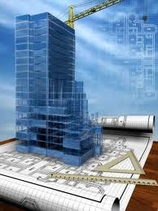
(1) building construction
(2) construction of heavy structures
(3) geotechnical engineering
(4) transportation engineering
(5) water resources engineering
(6) environment engineering
(7) town planning

Slide 12
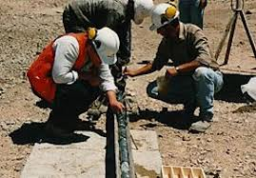
Scope of civil engineering according to the functions of civil engineering
(1) surveying
(2) planning
(3) structural analysis & design
(4) professional practice
(a) estimating
(b) costing & accounts
© valuation
(d) contracts

Slide 13
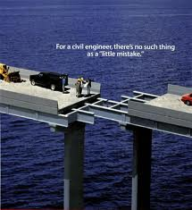
(5) construction management
(a) planning & scheduling
(b) construction execution and supervision
(6) quality control and research
(7) maintenance of structure

Slide 14
[1] Building construction :
Constructing residential building like apartment, tenements , flats , raw houses , bun glows , villas , quarters etc.
Constructing public building like schools , colleges , government office , hospital , shopping complexes , hostel , etc.
Constructing industrial buildings like workshops , ware houses, stores & industrial sheds.

Slide 15
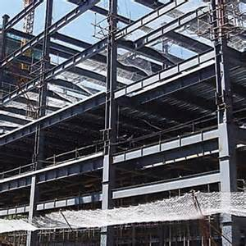
[ 2 ] construction of heavy structure :
Constructing bridges, dams, ports, airports, under water construction, tunnels, cofferdams, caissons, pipe foundation, well foundations etc. with advanced construction techniques.
It also includes study advanced techniques, modern equipment & materials.

Slide 16
[3] geotechnical engineering :
Constructing several types of foundations like simple footing, well foundation, pile foundation, coffer dams & foundations of machines subjected to vibrations is the main scope of geotechnical engineering.
It further includes constructing tunnels, earthen dames, earth work for highway & railways.
It also includes soil investigation & soil testing

Slide 17
[ 4 ] transportation engineering :
Constructing structures related to the transportation engineering like, roads railways, bridges, tunnels, ports, harbours, runways & airports.
It also includes traffic engineering & study of highway materials

Slide 18
[ 5 ] water resources engineering :
Constructing structures relating to water resources engineering like dams, barrages, canals, canal structures & hydro power station.
It also includes irrigation methods, water shed management, rain water harvesting,

Slide 19
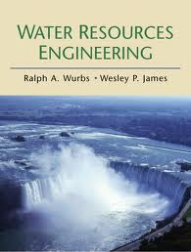

Slide 20
[ 6 ] Environmental engineering :
Constructing structures relating to public health engineering like units of water treatment plan, water distribution network, under ground sump, over head tank, units of waste water treatment plan sewerage & drainage system & pumping station.
It also includes pollution control & solid waste collection from the town & its disposal.

Slide 21
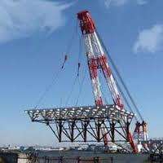
[ 7 ] town planning :
Planning of the town by zoning of the lead , planning road network, planning other services like water supply & drainage.
Preparing master plan of town planning schemes & construction by building byelaws.

Slide 22
Scope of civil engineering according to the functions of civil engineering : [ 1 ] surveying :
To carry out surveying for setting out of works & for preparing map of land.
Leveling is carried out to measure levels & to prepare contour map.
Measurements of distances & angles are taken with the help of surveying instruments.
Map are useful for planning of the construction project.

Slide 23
[ 2 ] planning :
To carry out planning of the different units according to their functional needs.
Say for building are constructed to create living space & roads are constructed for transportation of vehicles over them.
Technical feasibility study, economic viability study, environment impact analysis.
On the bases of the data collected & map prepared by surveying, planning of project is made.

Slide 24
[ 3 ] structural analysis & design :
To carry out structural design of the structure by selecting the type of material like concrete or steel & fixing the size & shape of various structural components like slab, beam column etc. structural analysis is required prior to the designing of the structure.

Slide 25
[ 4 ] professional practices :
( A ) Estimating :
To prepare estimate of work.
Estimates are prepared from data of drawings , specifications, rates etc.
The procedure for preparing estimate is know as estimating.

Slide 26
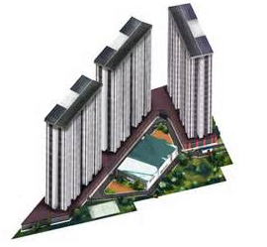
( B ) costing & accounts:
To carry out costing to know the actual expenditure in the payment of bills to the contractor , & many other expenditure , during construction of the work.

Slide 27
( C ) valuation :
To carry out valuation of the property like land or land with building.
Valuation is carried out for the purpose of knowing the fair & just price or market value of the property for the purpose of sales purchases, insurance, taking loans & other purpose.

Slide 28
( D ) contracts :
To carry out the construction of work through contractor according to the contract.
On the bases of the contractor s qualification, past performance & rates filled in the tender papers, work is allocated to the contractor.

Slide 29
( 4 ) construction management :
( a ) planning & scheduling :
To carry out project planning &prepare different schedules. Scheduling is the procedure of fixing the order of execution of different activities during construction.
For preparing schedules methods like bar chart & critical path methods are generally used.
Economic analysis is also carried out know the economic viability & to select one alternative among several other options

Slide 30
( B ) construction execution & supervision :
To carry out the actual execution of the construction of the structure & supervise the progress of the work as per plan, design & specification & condition of the contract.
During the actual construction engineer has to provide technical guidance to the contractor & monitor the progress.
Management practices during construction also includes handling of the equipments & material store. It also includes observing labour laws & safety precautions.

Slide 32
Thank you

